Slide 1
n₁: (at p₁ A)
Unload p₁ t₁ A
n₂: (at t₃ A) (on p₁ t₃)
Load p₁ t₃ A
Drive t₃ [3,1] A
Load p₁ t₃ B
X
n₃: (at t₃ A) (at p₁ A)
n₄: (at t₃ [3,1]) (on p₁ t₃)
n₅: (at t₃ A) (at t₃ B) (at p₁ B)
Unload p₁ t₃ A
Drive t₃ B [3,1]
X
n₆: (at t₃ A) (on p₁ t₃)
n₇: (at t₃ B) (on p₁ t₃)
Load p₁ t₃ B
Drive t₃ [3,1] B
X
n₈: (at t₃ B) (at p₁ B)
n₉: (at t₃ [3,1]) (on p₁ t₃)
Unload p₁ t₃ A
X
n₁₀: (at t₃ B) (on p₁ t₃)

Slide 2
(at t₃ A) (on p₁ t₃)
Drive t₃ [3,1] A
(at t₃ [3,1]) (on p₁ t₃)
Drive t₃ A [3,1]
Drive t₃ B [3,1]
(at t₃ A) (on p₁ t₃)
(at t₃ B) (on p₁ t₃)
(at t₃ C) (on p₁ t₃)
(at t₃ D) (on p₁ t₃)
Drive t₃ [3,1] B
Drive t₃ [3,1] B
Drive t₃ [3,1] B
(at t₃ [3,1]) (on p₁ t₃)
(at t₃ [3,1]) (on p₁ t₃)
(at t₃ [3,1]) (on p₁ t₃)

Slide 3

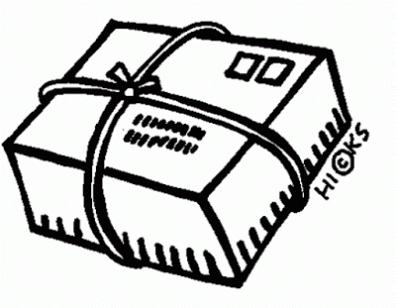
n₁: (at t A) (on p t)
Load_{r} p t A
Load_{r} p t C
Drive t B A
n₂: true
n₃: (at t B) (on p t)
n₄: false
Drive t A B
Drive t C B
Load p t B
n₅: (at t A) (on p t) ➔ false
n₆: (at t C) (on p t)
n₇: (at t B) (at p B)
Load_{r} p t C
Unload p t B
Init
n₈: true
n₁₀: (at t B) (on p t) ➔ false
n₉: true
A
B
C

